Slide 1
Make a DNS server

Slide 2
What are we talking about
Every thing on the internet has an IP address
We don’t want to remember IP addresses because they all look similar e.g. 213.43.75.13
So we use domain names like www.youtube.com
Your ISP help turn the domain name into an IP address so your computer knows where to ask for the information

Slide 3
The Algorithm
Hand-out 1
start
Input domain name
Explain the algorithm in your own words
Domain known?
No
Yes
Fetch page from IP address
Report error
“Don’t know that one!”
end

Slide 4
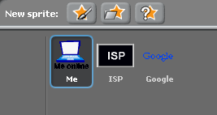
Make it in Scratch—Part 1
Three sprites!

Slide 5
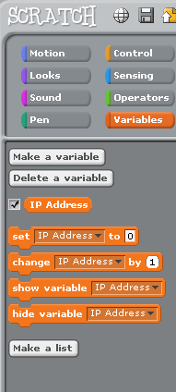
Make it in Scratch—Part 2
Make a variable
called IP Address

Slide 6
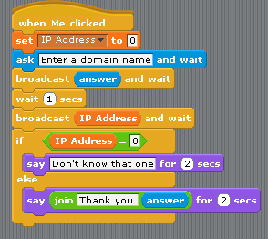
Make it in Scratch—Part 3
Code for the
‘Me’ sprite
(The Laptop)

Slide 7


Make it in Scratch—Part 4
Code for the
‘ISP’ sprite
Code for the
‘Google’ sprite

Slide 8
Exercise
Make sure the model works as you would expect
Add a new sprite called YouTube.
Add code to the ISP to set the IP address to 64.15.112.140 when it receives “youtube.com”
Add code to the new YouTube sprite to respond when it is called
Add additional websites in the same way.

Slide 9
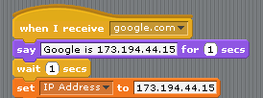
The code
Make a variable
called IP Address
Code for the
‘Me’ sprite
Code for the
‘ISP’ sprite
Code for the
‘Google’ sprite

Slide 10
What problems did you encounter today? How did you resolve them?

